Slide 1
Lecture – 17

Slide 2
Pipelining
An implementation technique in which multiple instructions are overlapped in execution.
It is used to make the processor fast.
Pipelining does not reduce the time to complete a single task but increases the throughput and the improvement in the throughput decreases the total time to complete the task.
The speed up due to pipelining is equal to the number of stages in the pipeline if
1. All the stages take about the same amount of time.
2. The number of tasks is large compared to the number of stages.

Slide 3
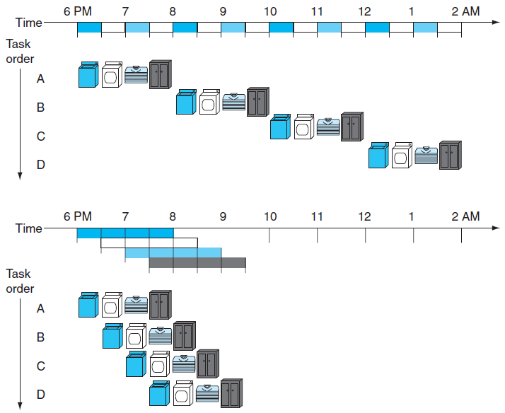
Laundry Analogy for Pipelining

Slide 4
MIPS Pipeline
Fetch instruction from the memory.
Read register while decoding the instruction.
Execute the operation or calculate an address.
Access an operand in data memory.
Write the result into a register.

Slide 5
Pipelined vs. Single-Cycle Instruction Execution
Instruction Class | Instruction Fetch | Register Read | ALU Operation | Data Access | Register Write | Total Time
Load Word (LW) | 200 ps | 100 ps | 200 ps | 200 ps | 100 ps | 800 ps
Store Word (SW) | 200 ps | 100 ps | 200 ps | 200 ps |  | 700 ps
R-format | 200 ps | 100 ps | 200 ps |  | 100 ps | 600 ps
Branch (Beq) | 200 ps | 100 ps | 200 ps |  |  | 500 ps

Slide 6
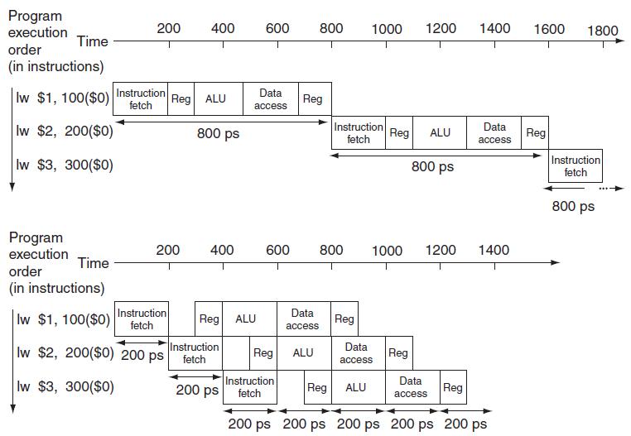

Pipelined vs. Single-Cycle Instruction Execution

Slide 7
Speed Up of Pipelining
Time between the instruction must be 160 ps. We get 200 ps due to imperfectly balanced stage.
With respect to total execution time, we get 2400 ps / 1400 ps = 1.7. This is due to small number of instruction.
Suppose, we have 1,0000,003 instructions. So, speed up = 1,0000,000 x 200 + 1400 / 1,0000,000 x 800 + 2400 ≈ 4.00

Slide 8
Pipelining MIPS
  all instructions are same length
    -so fetch and decode stages are similar for all instructions
  just a few instruction formats
    -simplifies instruction decode and makes it possible in one stage
  memory operands appear only in load/stores
    -so memory access can be deferred to exactly one later stage
  operands are aligned in memory
    -one data transfer instruction requires one memory access stage

Slide 9
Pipeline Hazards
  There are situations in pipelining when the next instruction cannot execute in the following clock cycle. These events are called hazards.
  There are three different types of hazards:
  Structural Hazards
  Data Hazards
  Control Hazards

Slide 10
Structural Hazards
An occurrence in which a planned instruction cannot execute in the proper clock cycle because the hardwire cannot support the combination of instruction that are set to execute in the given clock cycle.
E.g., suppose single – not separate – instruction and data memory in pipeline below with one read port
  then a structural hazard between first and fourth lw instructions

Slide 11
Structural Hazard
Time (clock cycles)
Cycle 1
Cycle 2
Cycle 3
Cycle 4
Cycle 5
Cycle 6
Cycle 7
I
n
s
t
r.
O
r
d
e
r
Load
Ifetch
Reg
ALU
DMem
Reg
DMem
Instr 1
Ifetch
Reg
ALU
DMem
Reg
Instr 2
Ifetch
Reg
ALU
DMem
Reg
Instr 3
Ifetch
Reg
ALU
DMem
Reg
Instr 4
Structural Hazard

Slide 12
Resolving Structural Hazards
Solution 1: Wait
- Must detect the hazard
- Must detect the mechanism to stall
Solution 2: Throw more hardware at the problem

Slide 13
Detecting and Resolving Structural Hazard
Time (clock cycles)
Cycle 1
Cycle 2
Cycle 3
Cycle 4
Cycle 5
Cycle 6
Cycle 7
I
n
s
t
r.
O
r
d
e
r
Load
Ifetch
Reg
ALU
DMem
Reg
Instr 1
Ifetch
Reg
ALU
DMem
Reg
Instr 2
Ifetch
Reg
ALU
DMem
Reg
Stall
Bubble
Bubble
Bubble
Bubble
Bubble
Instr 3
Ifetch
Reg
ALU
DMem
Reg

Slide 14
Data Hazards
An occurrence in which a planned instruction cannot execute in the proper clock cycle because data that is needed to execute the instruction is not yet available.
Instruction needs data from the result of a previous instruction still executing in pipeline

Slide 15
Data Hazards
Time (clock cycles)
IF
ID/RF
EX
MEM
WB
I
n
s
t
r.
O
r
d
e
r
add r1,r2,r3
Ifetch
Reg
ALU
DMem
Reg
sub r4,r1,r3
Ifetch
Reg
ALU
DMem
Reg
and r6,r1,r7
Ifetch
Reg
ALU
DMem
Reg
or r8,r1,r9
Ifetch
Reg
ALU
DMem
Reg
xor r10,r1,r11
Ifetch
Reg
ALU
DMem
Reg

Slide 16
Forwarding to Avoid Data Hazard
Time (clock cycles)
I
n
s
t
r.
O
r
d
e
r
add r1,r2,r3
Ifetch
Reg
ALU
DMem
Reg
sub r4,r1,r3
Ifetch
Reg
ALU
DMem
Reg
and r6,r1,r7
Ifetch
Reg
ALU
DMem
Reg
or r8,r1,r9
Ifetch
Reg
ALU
DMem
Reg
xor r10,r1,r11
Ifetch
Reg
ALU
DMem
Reg

Slide 17
Data Hazard Even with Forwarding (Load Data Hazard)
Time (clock cycles)
I
n
s
t
r.
O
r
d
e
r
lw r1, 0(r2)
Ifetch
Reg
ALU
DMem
Reg
sub r4,r1,r6
Ifetch
Reg
ALU
DMem
Reg
and r6,r1,r7
Ifetch
Reg
ALU
DMem
Reg
or r8,r1,r9
Ifetch
Reg
ALU
DMem
Reg
Notes:
MIPS actutally didn’t interlecok: MPU without Interlocked Pipelined Stages

Slide 18
Resolving the Load Data Hazard
Time (clock cycles)
I
n
s
t
r.
O
r
d
e
r
lw r1, 0(r2)
Ifetch
Reg
ALU
DMem
Reg
Bubble
sub r4,r1,r6
Ifetch
Reg
ALU
DMem
Reg
Bubble
and r6,r1,r7
Ifetch
Reg
ALU
DMem
Reg
Bubble
or r8,r1,r9
Ifetch
Reg
ALU
DMem

Slide 19
Software Scheduling to Avoid Load Hazards
Try producing fast code for
a = b + c;
d = e – f;
assuming a, b, c, d ,e, and f in memory.
Slow code:
LW Rb,b
LW Rc,c
ADD Ra,Rb,Rc
SW a,Ra
LW Re,e
LW Rf,f
SUB Rd,Re,Rf
SW d,Rd
Fast code:
LW Rb,b
LW Rc,c
LW Re,e
ADD Ra,Rb,Rc
LW Rf,f
SW a,Ra
SUB Rd,Re,Rf
SW d,Rd

Slide 20
Control Hazards/ Branch Hazards
An occurrence in which the proper instruction cannot execute in the proper clock cycle because the instruction that was fetched is not the one that is needed.
Arises from the need to make a decision based on the result of one instruction while others are executing.

Slide 21
Control Hazards
Control hazard: need to make a decision based on the result of a previous instruction still executing in pipeline
Solution 1 Stall the pipeline
P
r
o
g
r
a
m
e
x
e
c
u
t
i
o
n
2
4
6
8
1
0
1
2
1
4
1
6
o
r
d
e
r
T
i
m
e
(
i
n
i
n
s
t
r
u
c
t
i
o
n
s
)
I
n
s
t
r
u
c
t
i
o
n
R
e
g
A
L
U
D
a
t
a
R
e
g
Note that branch outcome is
computed in ID stage with
added hardware (later…)
a
d
d
$
4
,
$
5
,
$
6
f
e
t
c
h
a
c
c
e
s
s
b
e
q
$
1
,
$
2
,
4
0
I
n
s
t
r
u
c
t
i
o
n
R
e
g
A
L
U
D
a
t
a
R
e
g
2
n
s
f
e
t
c
h
a
c
c
e
s
s
l
w
$
3
,
3
0
0
(
$
0
)
b
u
b
b
l
e
I
n
s
t
r
u
c
t
i
o
n
R
e
g
A
L
U
D
a
t
a
R
e
g
f
e
t
c
h
a
c
c
e
s
s
4
n
s
2
n
s
Pipeline stall

Slide 22
Control Hazards
Solution 2 Predict branch outcome
  e.g., predict branch-not-taken :
P
r
o
g
r
a
m
e
x
e
c
u
t
i
o
n
T
i
m
e
2
4
6
8
1
0
1
2
1
4
o
r
d
e
r
(
i
n
i
n
s
t
r
u
c
t
i
o
n
s
)
a
d
d
$
4
,
$
5
,
$
6
I
n
s
t
r
u
c
t
i
o
n
R
e
g
A
L
U
D
a
t
a
R
e
g
f
e
t
c
h
a
c
c
e
s
s
b
e
q
$
1
,
$
2
,
4
0
I
n
s
t
r
u
c
t
i
o
n
R
e
g
A
L
U
D
a
t
a
R
e
g
2
n
s
f
e
t
c
h
a
c
c
e
s
s
l
w
$
3
,
3
0
0
(
$
0
)
I
n
s
t
r
u
c
t
i
o
n
R
e
g
A
L
U
D
a
t
a
R
e
g
2
n
s
f
e
t
c
h
a
c
c
e
s
s
Prediction success
P
r
o
g
r
a
m
1
4
e
x
e
c
u
t
i
o
n
T
i
m
e
2
4
6
8
1
0
1
2
o
r
d
e
r
(
i
n
i
n
s
t
r
u
c
t
i
o
n
s
)
a
d
d
$
4
,
$
5
,
$
6
I
n
s
t
r
u
c
t
i
o
n
R
e
g
A
L
U
D
a
t
a
R
e
g
f
e
t
c
h
a
c
c
e
s
s
b
e
q
$
1
,
$
2
,
4
0
I
n
s
t
r
u
c
t
i
o
n
R
e
g
A
L
U
D
a
t
a
R
e
g
2
n
s
f
e
t
c
h
a
c
c
e
s
s
b
u
b
b
l
e
b
u
b
b
l
e
b
u
b
b
l
e
b
u
b
b
l
e
b
u
b
b
l
e
o
r
$
7
,
$
8
,
$
9
I
n
s
t
r
u
c
t
i
o
n
R
e
g
A
L
U
D
a
t
a
R
e
g
4
n
s
f
e
t
c
h
a
c
c
e
s
s
Prediction failure: undo (=flush) lw

Slide 23

Single-Cycle Datapath “Steps”
ADD
4
ADD
PC
<<2
ADDR
RD
Instruction
I
Instruction
32
16
32
5
5
5
Memory
RN1
RN2
WN
Register File
RD1
ALU
Zero
WD
RD2
M
U
ADDR
X
Data
E
Memory
RD
M
16
X
32
U
T
WD
X
N
D
IF
Instruction Fetch
ID
Instruction Decode
EX
Execute/ Address Calc.
MEM
Memory Access
WB
Write Back

Slide 24
Pipelined Datapath
Pipeline registers
wide enough to hold data coming in
ADD
4
64 bits
128 bits
ADD
PC
<<2
97 bits
64 bits
ADDR
RD
Instruction
I
Instruction
32
16
32
5
5
5
Memory
RN1
RN2
WN
Register File
RD1
ALU
Zero
WD
RD2
M
U
ADDR
X
Data
E
Memory
RD
M
16
X
32
U
T
WD
X
N
D
IF/ID
ID/EX
EX/MEM
MEM/WB

Slide 25
Pipelined Datapath
No pipeline register at the end of write back stage. In this stage we write a register in the register file and any later instruction can get this data by reading this register. So no need for redundant register.
Each component of the data path is associated with a single stage.
Each register contains a portion of the instruction needed for that stage and later stages.

Slide 26
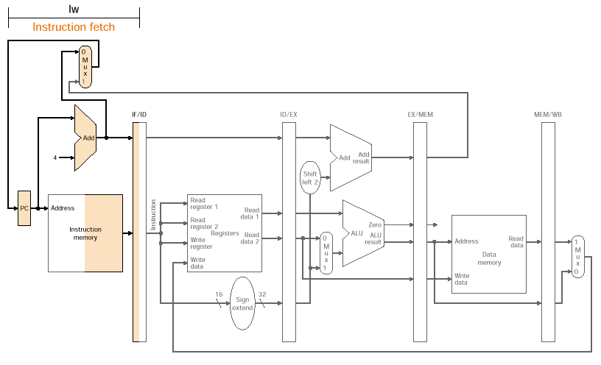
Pipeline Flow (lw example)

Slide 27
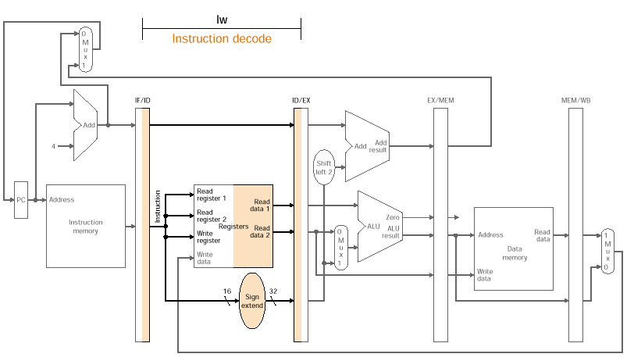
Pipeline Flow (lw example)

Slide 28
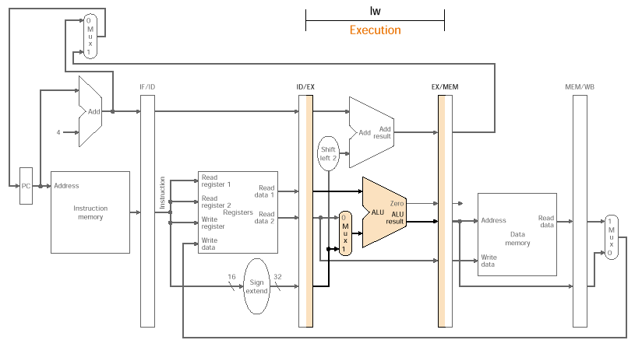
Pipeline Flow (lw example)

Slide 29
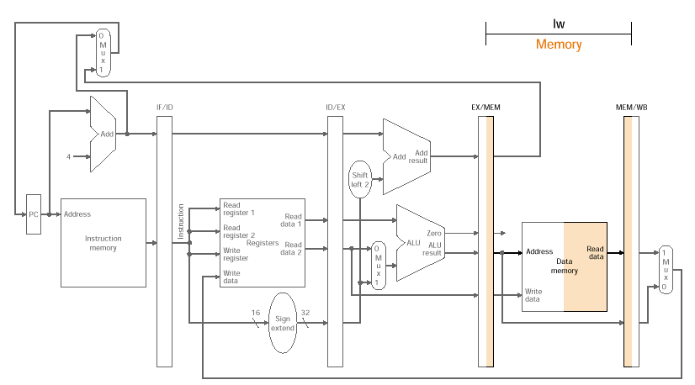
Pipeline Flow (lw example)

Slide 30
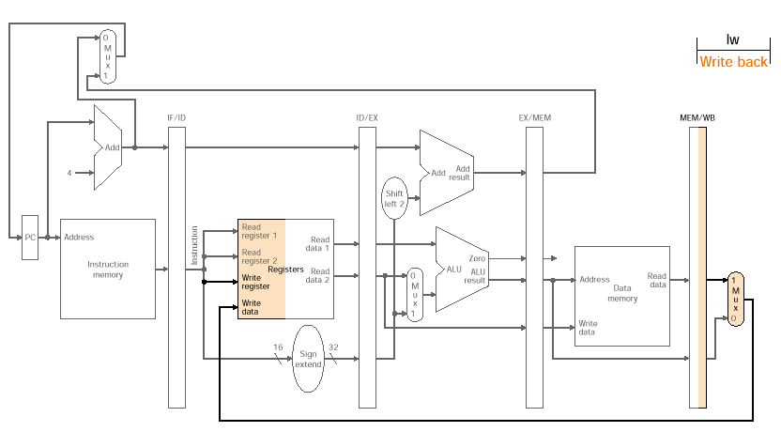
Pipeline Flow (lw example)

Slide 31
Pipelined Example
Consider the following instruction sequence:
lw $t0, 10($t1)
sw $t3, 20($t4)
add $t5, $t6, $t7
sub $t8, $t9, $t10

Slide 32
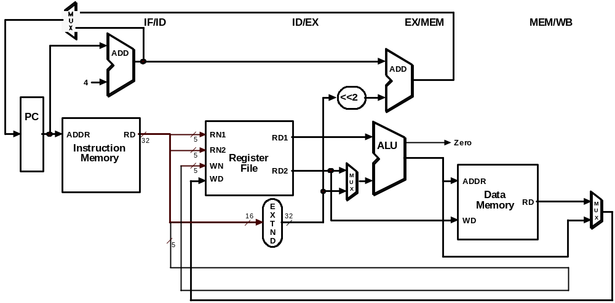
Single-Clock-Cycle Diagram:
Clock Cycle 1
LW

Slide 33
Single-Clock-Cycle Diagram:
Clock Cycle 2
SW
LW

Slide 34
Single-Clock-Cycle Diagram:
Clock Cycle 3
ADD
SW
LW

Slide 35
Single-Clock-Cycle Diagram:
Clock Cycle 4
SUB
ADD
SW
LW

Slide 36
Single-Clock-Cycle Diagram:
Clock Cycle 5
SUB
ADD
SW
LW

Slide 37
Single-Clock-Cycle Diagram:
Clock Cycle 6
SUB
ADD
SW

Slide 38
Single-Clock-Cycle Diagram:
Clock Cycle 7
SUB
ADD

Slide 39
Single-Clock-Cycle Diagram:
Clock Cycle 8
SUB

Slide 40
Alternative View –
Multiple-Clock-Cycle Diagram
CC 1
CC 2
CC 3
CC 4
CC 5
CC 6
Time axis
CC 7
CC 8
lw $t0, 10($t1)
IM
REG
ALU
DM
REG
sw $t3, 20($t4)
IM
REG
ALU
DM
REG
add $t5, $t6, $t7
IM
REG
ALU
DM
REG
sub
$t8, $t9, $t10
IM
REG
ALU
DM
REG

Slide 41
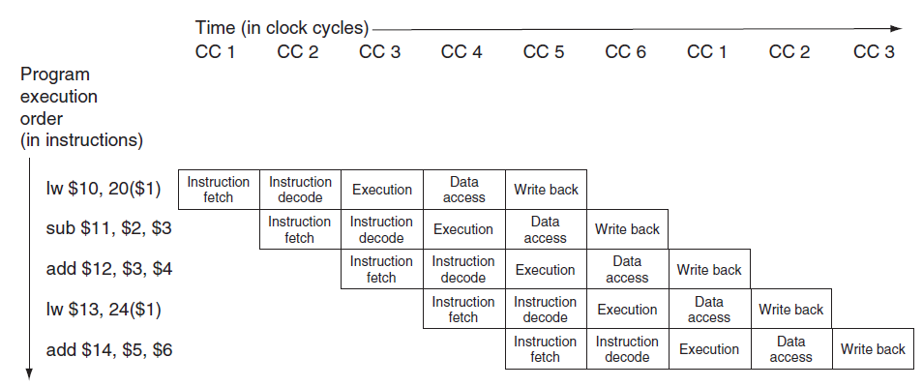
Another View –
Multiple-Clock-Cycle Diagram

